Slide 1
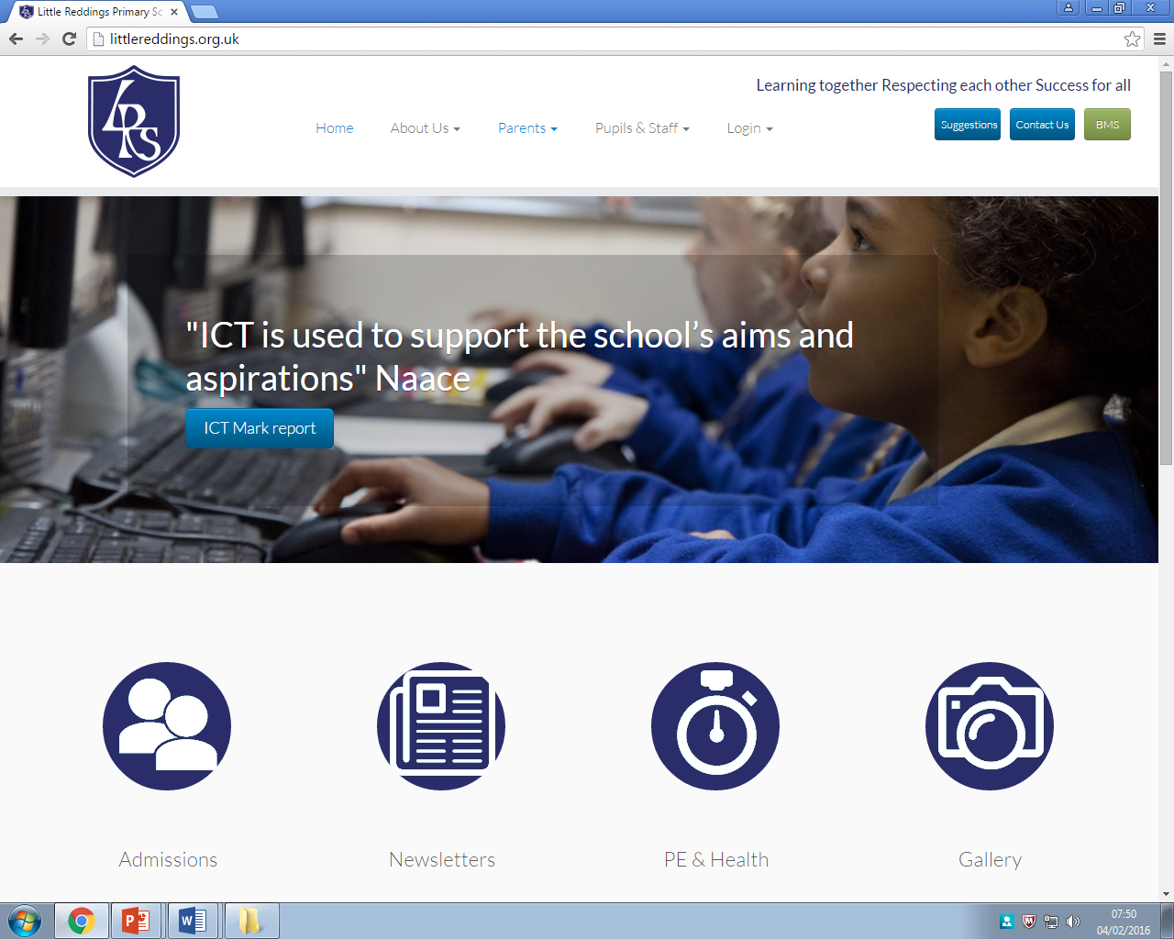
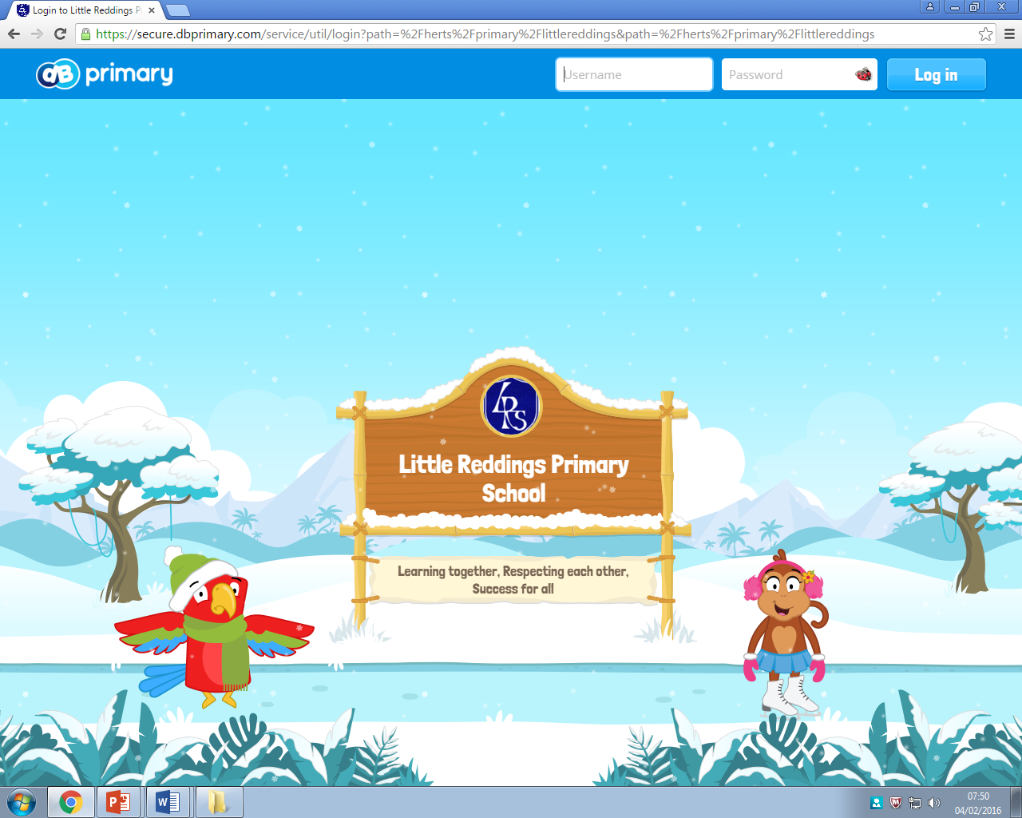
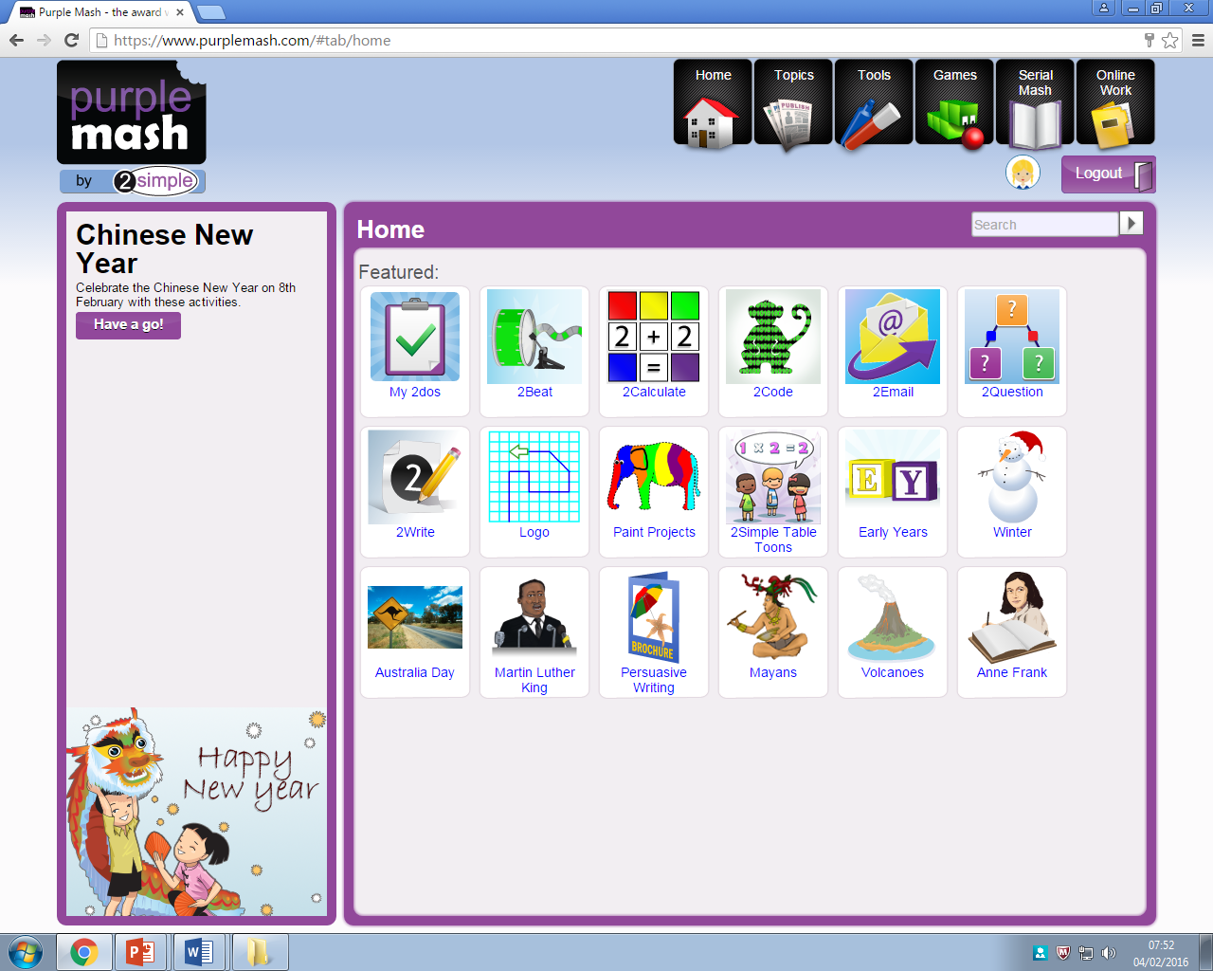
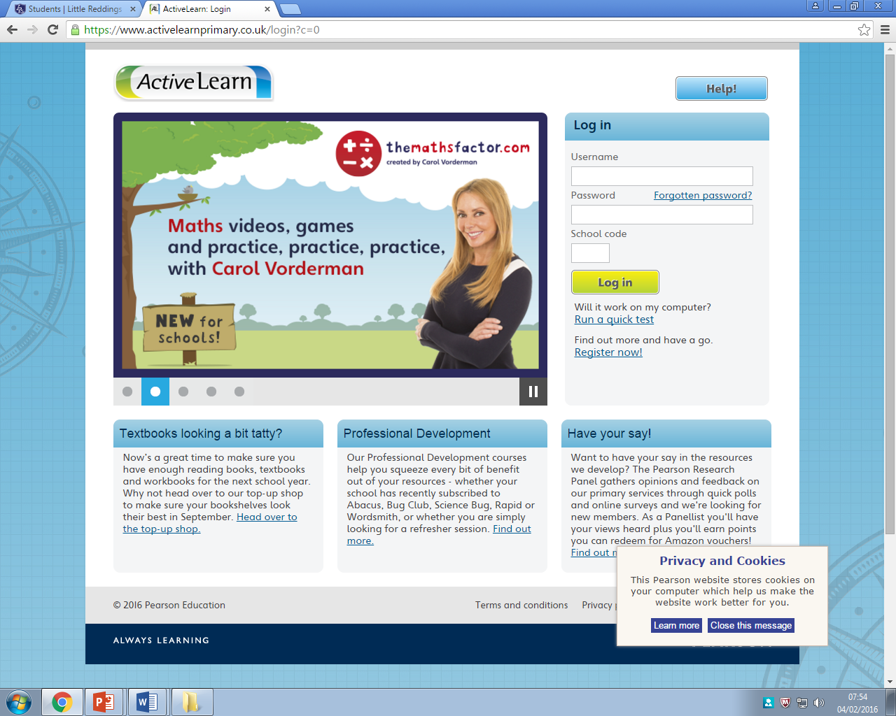
How does technology help my child learn?
08/02/16

Slide 2
How does technology help my child learn?
Agenda
LRS website content
Video learning and communication
LRS online resources

Slide 3
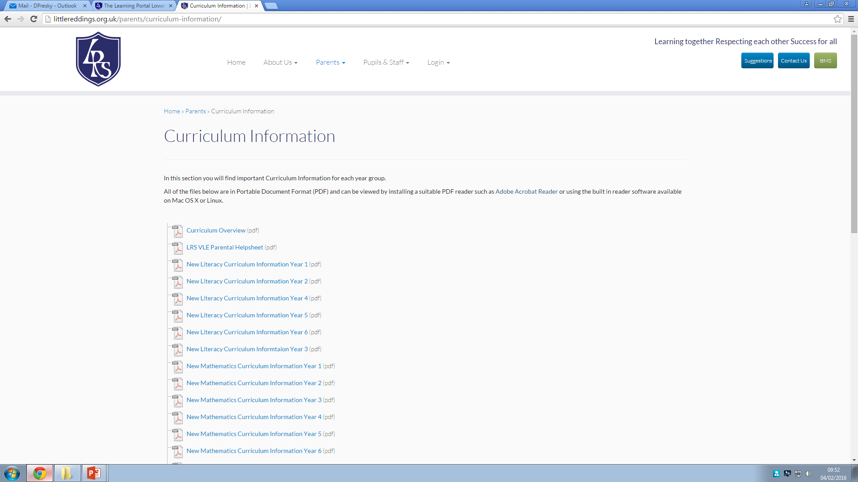
LRS website content
Curriculum information

Slide 4
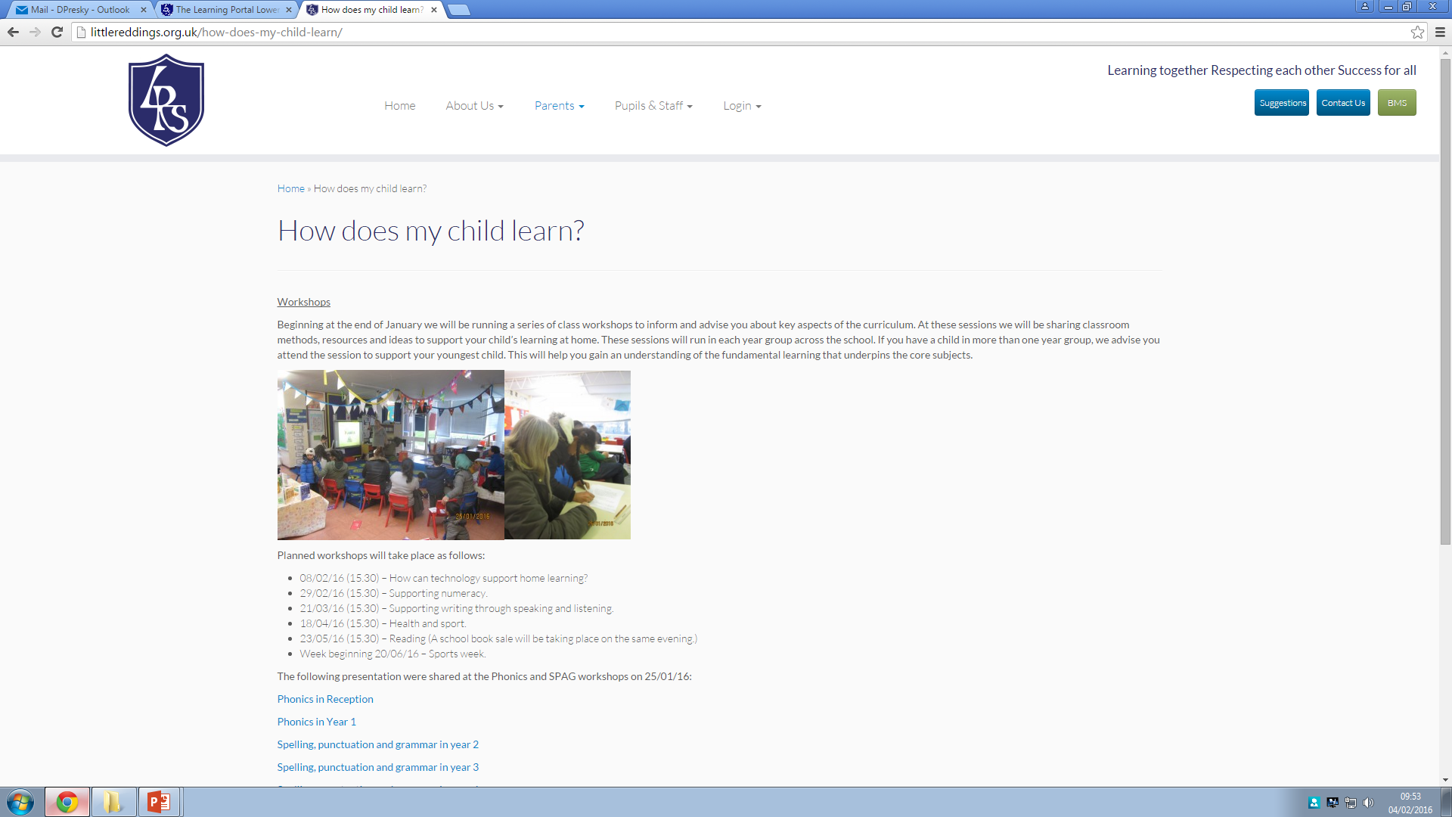
LRS website content
Workshop resources

Slide 5
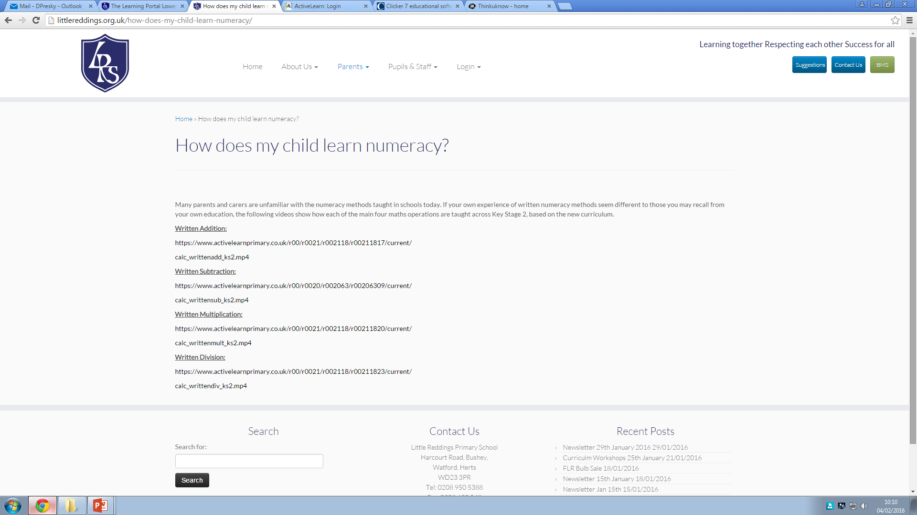
LRS website content
How does my child learn numeracy ?

Slide 6
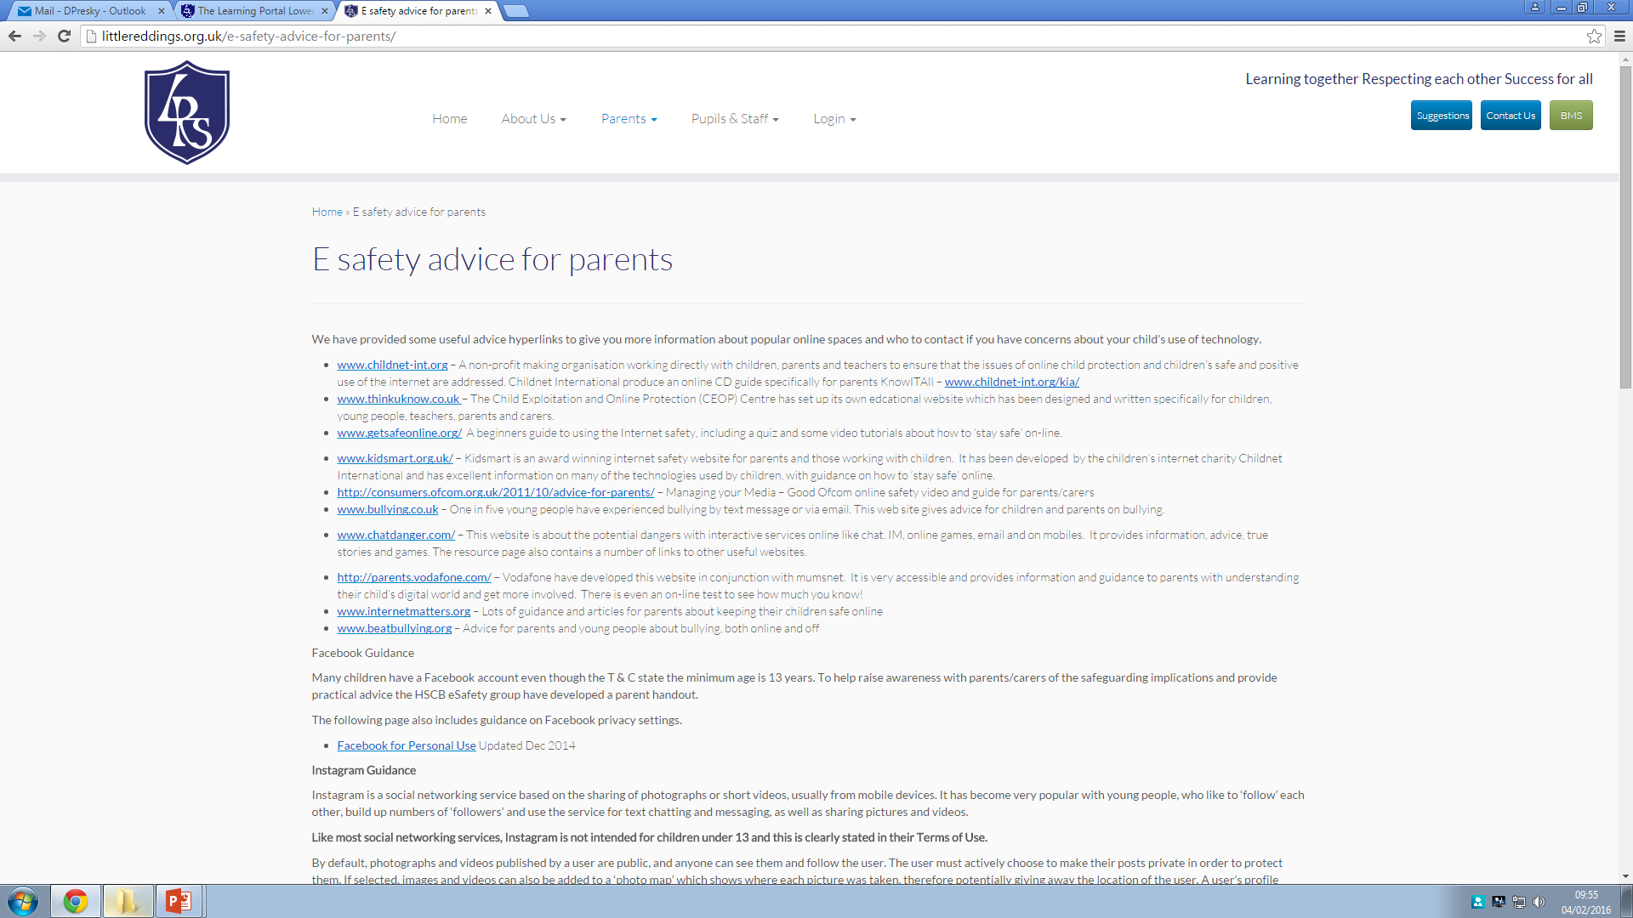
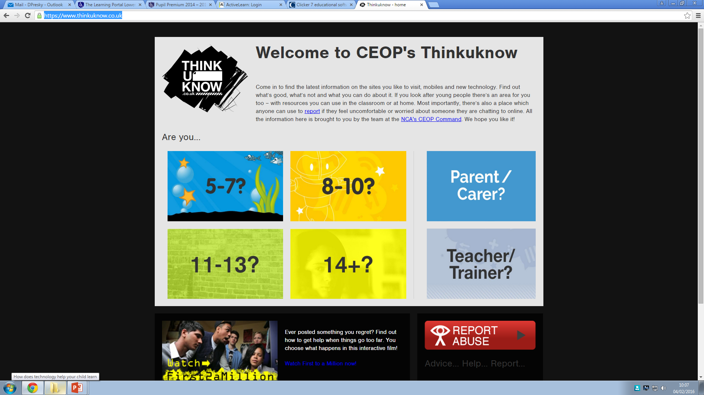
LRS website content
E safety

Slide 7
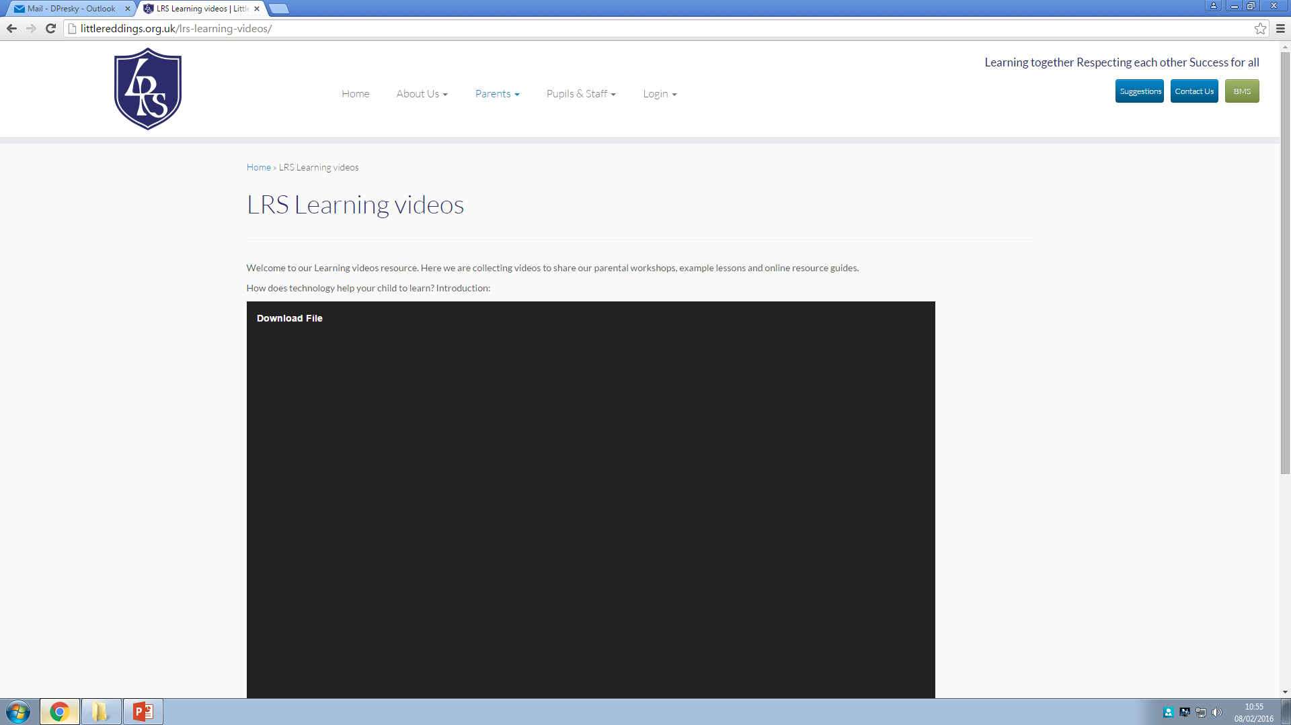
LRS website content
LRS Learning videos and communication

Slide 8
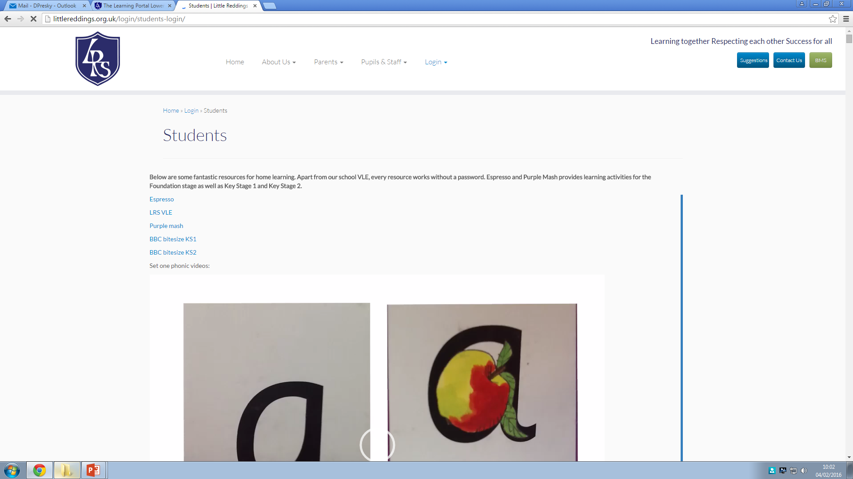
Online resources
Curriculum resources - Espresso
Curriculum resources - Purple Mash
VLE community
VLE Learning Portal
Purple Mash:
Username: example_pupil
Password: bird3

Slide 9
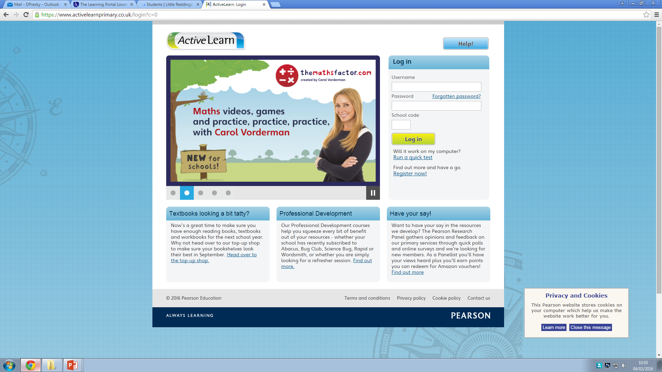
Online resources
Numeracy engagement - Abacus
Writing support - Clicker 6 and 7

